Slide 1

DIY Lab DY17003
GROUP P
Section 20

Slide 2

Himadri Pandya (20ME10047)
Samarth Singh (20MF10031)
Kondapalli Vivek Abhiram (20IM30008)
Navya Jattan (20MA20037)

Slide 3

Mask Detection
Face Detection Using OpenCV
Model to recognize faces wearing a mask

Slide 4
Objectives
Using Face Mask Detection System, Hospitals can monitor if their staff is wearing masks during their shift or not. If any health worker is found without a mask, it will be visible in the feed.
The Face Mask Detection System can also be used in office premises to detect if employees are maintaining necessary precautions at work. It efficiently monitors employees with/without masks.
Other implementable areas are railway stations, schools and public places.

Slide 5
Face Detection Using OpenCV
Haar Cascade algorithm, also known as Voila-Jones algorithm to detect faces. It is basically a machine learning object detection algorithm which is used to identify objects in an image or video. In OpenCV, we have several trained Haar Cascade models which are saved as XML files. Instead of creating and training the model from scratch, we use this file. We are going to use “haarcascade_frontalface_alt2.xml” file in this project.
path to the XML file of goes as an argument to CascadeClassifier() method of OpenCV.
The CascadeClassifier() object we created has a method detectMultiScale(), which receives a frame(image) as an argument and runs the classifier cascade over the image. The term MultiScale indicates that the algorithm looks at subregions of the image in multiple scales, to detect faces of varying sizes.

Slide 6
Model to recognize faces wearing a mask classifier that can differentiate between faces with masks and without masks
creating this classifier, we need data in the form of Images containing images with mask on and off Since these images are very less in number, we cannot train a neural network from scratch. Instead, we finetune a pre-trained network called MobileNetV2 which is trained on the Imagenet dataset.
dataset is contained in two folders viz- with_masks and without_masks. So we can easily get the labels by extracting the folder name from the path. Also, the images were preprocessed image and resize it to 224x 224 dimensions.
loaded the pre-trained model and customize it according to our problem. So we just remove the top layers of this pre-trained model and add few layers of our own. As you can see the last layer has two nodes as we have only two outputs. This is called transfer learning.
Now we need to convert the labels into one-hot encoding. After that, we split the data into training and testing sets to evaluate them. Also, the next step is data augmentation which significantly increases the diversity of data available for training models, without actually collecting new data. Data augmentation techniques such as cropping, rotation, shearing and horizontal flipping are commonly used to train large neural networks.

Slide 7
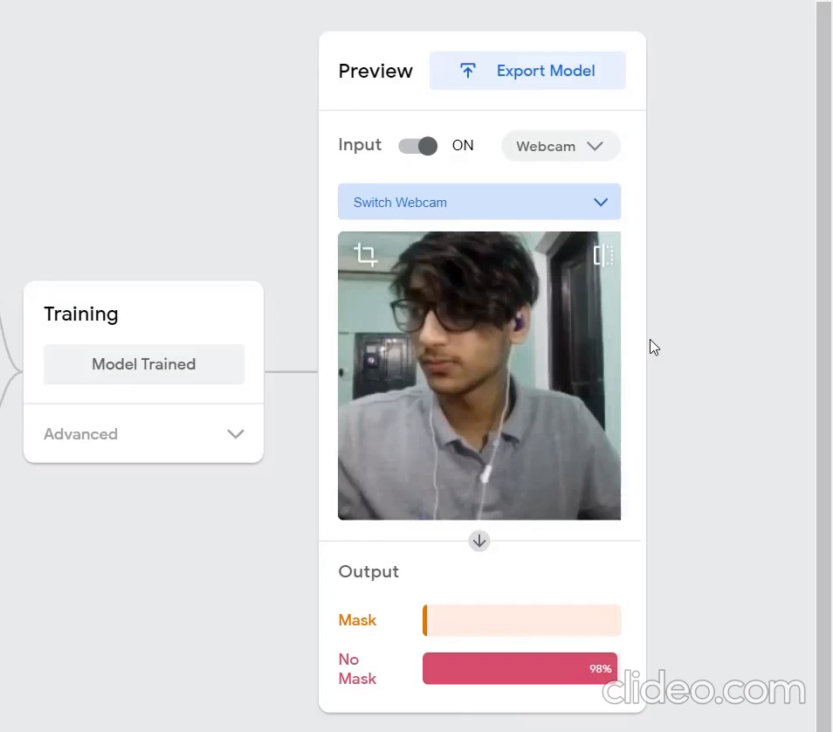
Google Teachable Machine

Slide 8
Video Feed Model
This model builds upon our previous work and gives a more real-time approach. It combines all the image frames captured from the camera and stores in in an array; it integrates the frame capture and displays whether the face recognized in the feed is wearing a mask or not. It finally displays this output with a frame around the recognized face.

Slide 9

Improvisations in the Video Feed Model
Real-time Identification: The program readily captures the video frames and gives the result with minimal lag.
Multiple-face Detection: The model can recognize more than one faces in the feed.

Slide 10
Contribution of Members
Himadri Pandya: Coding of video feed and presentation.
Kondapalli Vivek Abhiram: Video Editing and Resource collection.
Samarth Singh: Coding of image feed and presentation.
Navya Jattan: Research and documentation.

Slide 11
Thank You

